Slide 1
Curriculum Development and Revision Policy Faculty of Commerce and Management Studies, University of Kelaniya

Slide 2
Aims of the Policy
To establish a clear philosophy and goals that guide developing and revising the curriculum of the degree programs of the faculty.
To contribute to the assurance and enhancement of the quality of curricula at the Faculty of Commerce and Management Studies.
To ensure the time frame for regular curriculum reviews and/or new curriculum developments with changing disciplinary, educational, and social circumstances.
To suggest met
hods of assessing the achievement of the program's goals and objectives. To provide direction for obtaining human, material, and financial resources to implement the program.
To provide a guide to identify and develop a curriculum with the needs of national higher education policies and frameworks.

Slide 3
Requirements for Curriculum Revision
Major Revisions –Approval of UGC is needed.
Changes to the number of academic years required for the study program.
Changes to SLQF qualification type with designators and qualifiers
Changes to SLQF exit level.
Adding or removing lateral entry and early exit possibilities.
Introduction of a specialization/majoring area in an existing degree program
6Deleting or substituting one or more specialization / major or minor areas in an existing degree program.

Slide 4
Requirements for Curriculum Revision
Minor Revision: Minor changes should be undertaken at the Departmental level and finally must receive approval from the Academic Senate and the University Council.
1. Revisions to Assessment Criteria
2. Changes to course units
Course code and title
Content
Credit value
Semester etc

Slide 5
New Curriculum Development Process
Phase 1: Identification of the need of the proposed curriculum for the new degree program
Phase 2: Action for the curriculum development- Stakeholder
Phase 3: Develop the Graduate Profile and Programme Learning Outcomes (PLOs) for the proposed degree program
Phase 4: Identification of course pillars and credit values
Phase 5: Identify the progression of the course unit under each sub-pillar from level 1 to level 4.
Phase 6: Identify the Intended Learning Outcomes (ILOs) for each course unit
Phase 7: After identifying the ILOs for each course unit, the notional hours for each course unit should be determined
Phase 8: Development of course units
Phase 9: Finalization for approval

Slide 6
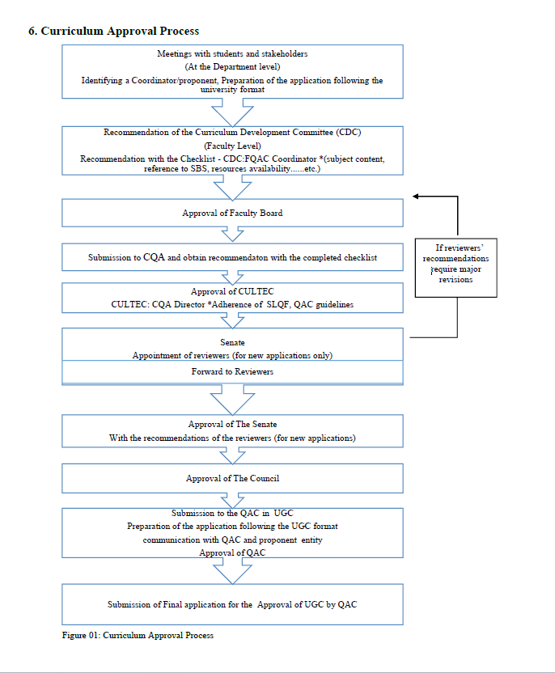
Curriculum Approval Process

Slide 7
Composition of Duties and Responsibilities of the Curriculum Development and Revision Committee
Curriculum Development and Revision Committee - Members of the committee are responsible for designing and reviewing curricula in line with the policy development guidelines. Committee members shall be represented by lecturers from the respective departments. The composition of the committee is as follows; a minimum of two professors, and lecturers of the respective discipline.
Head of the Department -The head of the department shall have the leadership and authority to guide academic staff in relation to curriculum development and decision processes and take responsibility for the revision that takes place within the department. He/she should appoint a chair and members to the curriculum revision committee and, must ensure that the committee is designing and reviewing curricula in line with the policy development guidelines.
Management Committee of the Faculty (Faculty Quality Assurance Cell (FQAC) FQAC should carry out required checking on conformity to the faculty, university, and UGC/CQA guidelines. FQAC shall forward the documents with their recommendations to the Dean to be tabled at the Faculty Board.
Faculty Board - Members of the faculty board are required to review the developed or revised curriculum and provide comments.
Centre for Quality Assurance (CQA) - CQA is required to provide the recommendation with the completed checklist.
Curriculum Teaching and Evaluation Committee (CULTEC)- CULTEC should carry the required checking and should approve the document to the next level.
University Senate- It is required to appoint relevant reviewers, send the developed curriculum to the reviewers, and provide recommendations.
University Council- It is required to provide the approval for the developed /revised curriculum.
Quality Assurance Council in University Grants Commission- Provide the approval for the compiled document prepared as per the UGC format

Slide 8
Monitoring and Evaluation of the Curriculum
At the end of each semester, evaluation should be done at the department level under the supervision of the head of the department. If there is any issue with the evaluation outcomes, the reasons should be identified, and necessary actions should be taken. (Internal mechanism to regularly monitor and annually review).

